Slide 1
READ ME This template uses the font ‘Space Grotesk’ – be sure to download the font before making edits to the deck. Here’s the link to the ZIP file containing the font. If you cannot access the link above, you can download the font for free via Google Fonts.

Slide 2
Building Intelligent App with Semantic Kernel

Slide 3
Only use Azure OpenAI to build intelligent app?

Slide 4
Not really!

Slide 5
Azure OpenAI
OpenAI
Llama
Gemini
Hugging Face

Slide 6
Any LLM can be integrated through Semantic Kernel

Slide 7
Your codes are seamlessly integrated with PROMPTS

Slide 8
Try Polyglot Notebooks

Slide 9
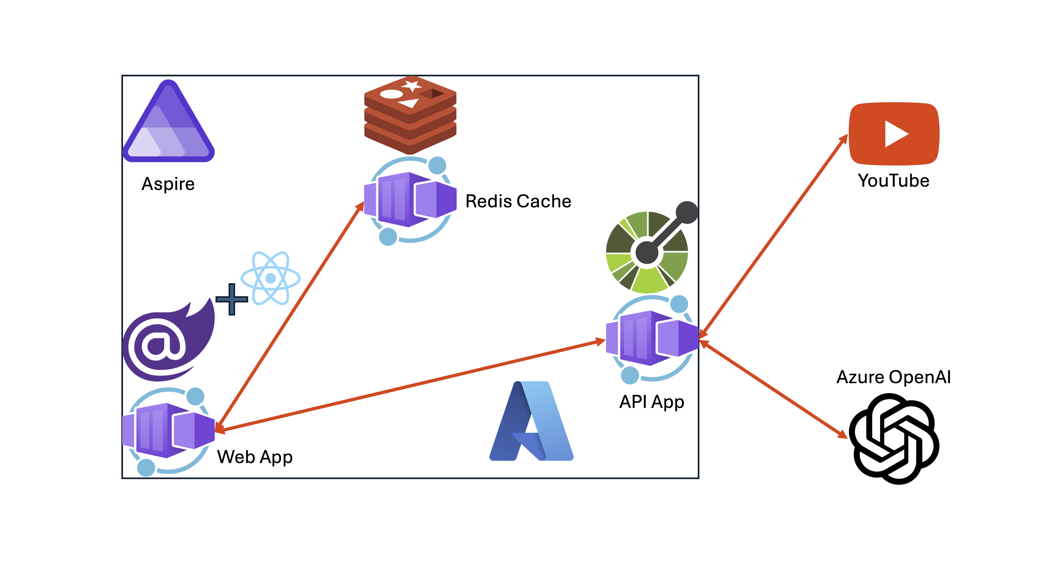

Slide 10
Let’s get started!
https://aka.ms/aspireinadaykr

